Slide 1
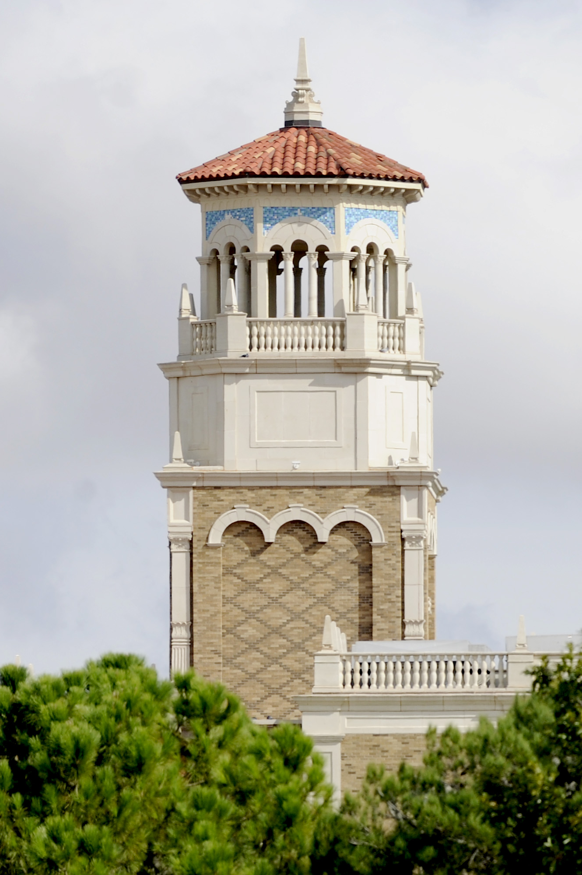
Civil War Battlefield Experience: Historical event simulation using Augmented Reality Technology
Vinh T. Nguyen, Kwanghee Jung, Seung-Chul Yoo, Seungman Kim, Sohyun Park, and Melissa Currie
San Diego, California, USA, December 9-11, 2019

Slide 2
Agenda
Introduction
Related work
Our approach
Demo
Conclusion and Future work

Slide 3
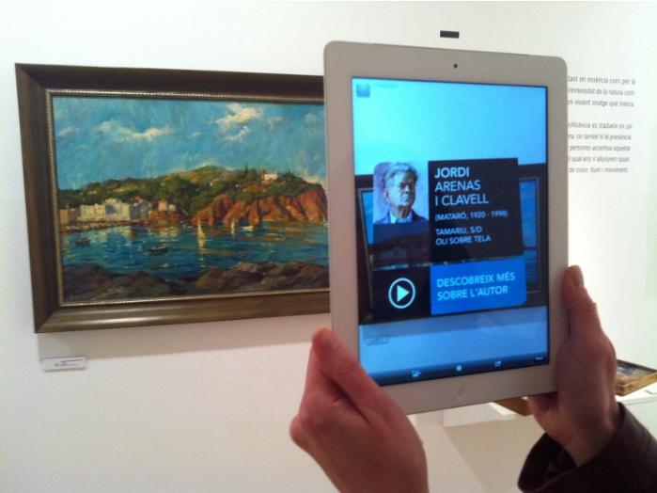
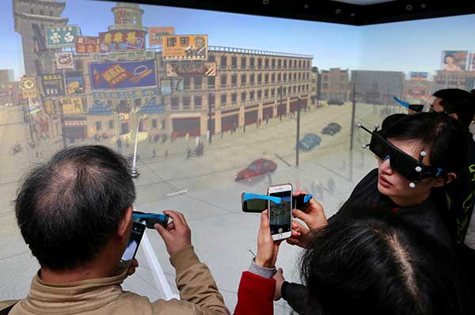
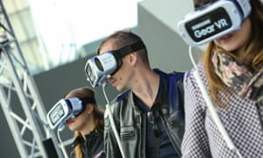
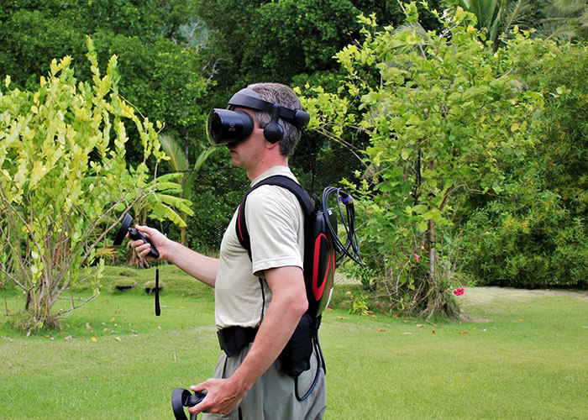
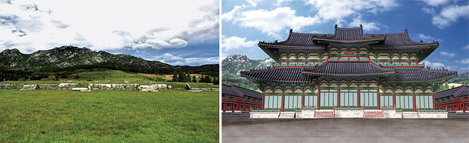
Introduction
Notes:
Cultural preservation plays an important role in maintaining our identity. A lot of effort has been devoted to preserving history through formal education or exhibiting artifacts in museums. However, artifacts positioned at the site, lost historical buildings that cannot be reconstructed, or battlefield events that cannot be recreated, make it difficult for the majority of interested viewers to experience them. To alleviate this obstacle and to promote cultural values, a wide range of modern technologies have been adapted to bring people closer to their historical identity. One of the most popular approaches is to create a virtual artifact using virtual reality and augmented reality to reconstruct the models and let viewers experience them. However, due to the distance or lack of Head Mounted Display it is still difficult to get viewers explore the products, especially when it comes to a series of historical events.

Slide 4
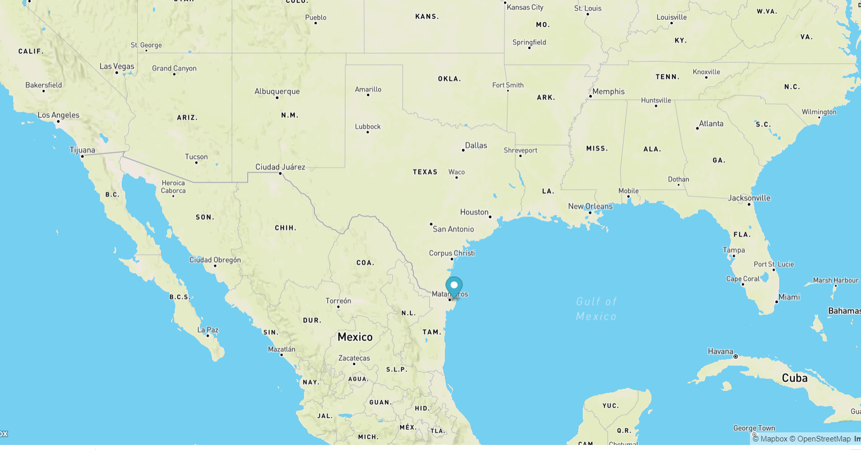
The Battle of Palmito Ranch
Notes:
Cultural preservation plays an important role in maintaining our identity. A lot of effort has been devoted to preserving history through formal education or exhibiting artifacts in museums. However, artifacts positioned at the site, lost historical buildings that cannot be reconstructed, or battlefield events that cannot be recreated, make it difficult for the majority of interested viewers to experience them. To alleviate this obstacle and to promote cultural values, a wide range of modern technologies have been adapted to bring people closer to their historical identity. One of the most popular approaches is to create a virtual artifact using virtual reality and augmented reality to reconstruct the models and let viewers experience them. However, due to the distance or lack of Head Mounted Display it is still difficult to get viewers explore the products, especially when it comes to a series of historical events.

Slide 5
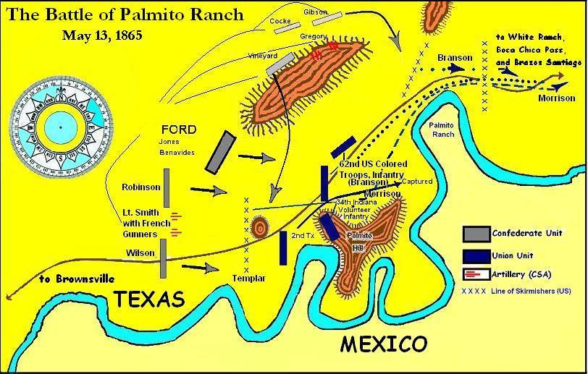
The Battle of Palmito Ranch
Notes:
A rich history unfolding over hundreds or even millions of years is always prone to gaps in learning and understanding a country's culture, especially when considering an individual state within that country. Palmito Ranch Battlefield in Cameron County, Texas, for example, is one of the most significant historical sites in the American Civil War, but few people are aware of it. The historic battle of Palmito Ranch occurred on May 12th to 13th, 1865 as a Union campaign of expedition from Brazos Santiago, Texas. It is the site of the last land battle fought in the Civil War and actually occurred after the war had officially ended with the Confederate Army (South) surrendering to the Union Army (North).

Slide 6
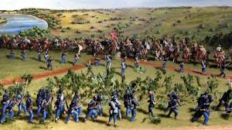
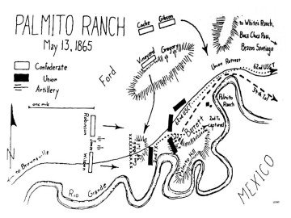
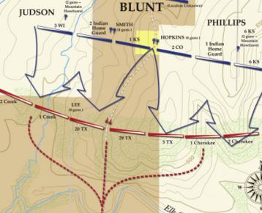
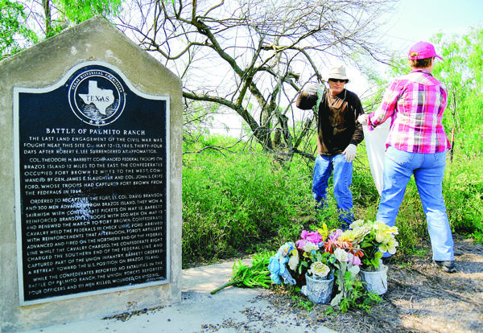
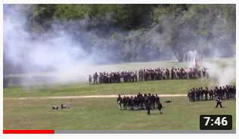
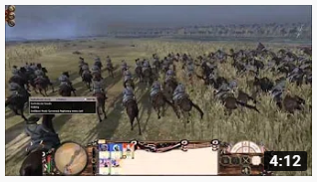
The Battle of Palmito Ranch
Notes:
Several programs administered by agencies including the National Park Service (e.g., Battlefield Planning Grants, Battlefield Land Acquisition Grants, Palmito Ranch Battlefield Preservation Plan (PRBPP) have been set up to promote the preservation, management, and interpretation of significant historical battlefields as cultural landscapes. To the best of our knowledge, no other studies exist exploiting the use of Augmented Reality to simulate this battle. This paper tries to fill this gap by proposing a web-based Augmented Reality Application that helps promote cultural identity by enabling students and tourists to experience a historically significant Civil War site in Texas

Slide 7
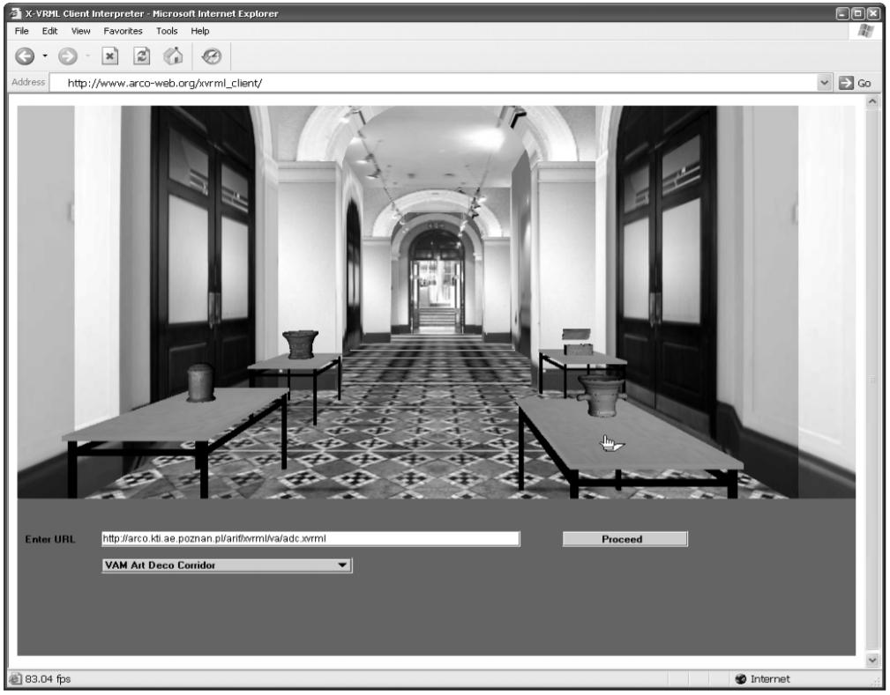
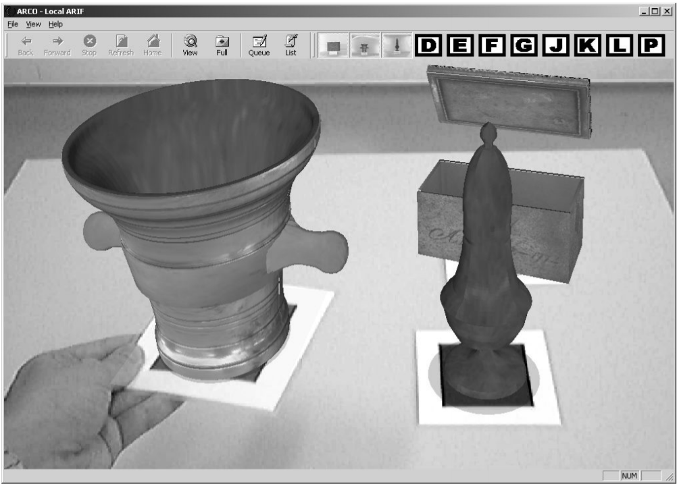
Related work
Wojciechowski, Rafal, et al. "Building virtual and augmented reality museum exhibitions." Proceedings of the ninth international conference on 3D Web technology. ACM, 2004.
Notes:
Rafal et al presented the Augmented Representation of Cultural Objects (ARCO) project which allows designers to create, manipulate and present virtual 3D cultural objects in both VR and AR environments. The proposed system consists of three main components, including content production, content management, and visualization. The content acquisition components include object creation and manipulation. These digitized virtual objects are stored in the repository where the application layer will query and render to the 3D environment or superimpose them onto a marker

Slide 8
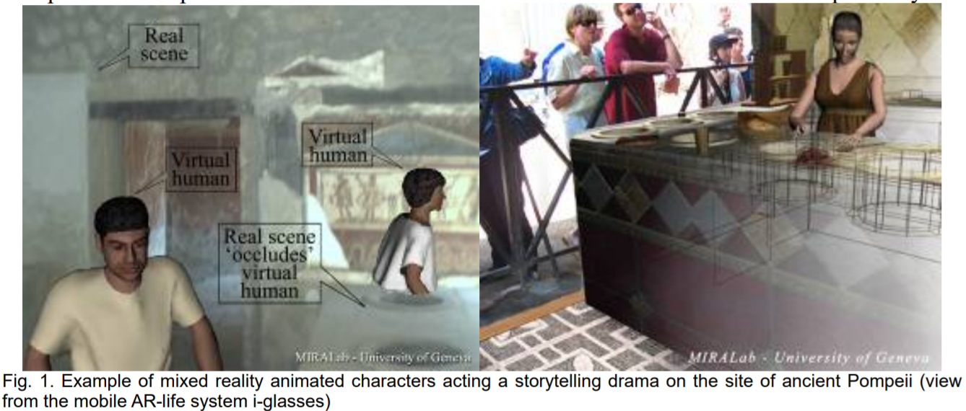
Related work
Magnenat-Thalmann, Nadia, and George Papagiannakis. "Virtual worlds and augmented reality in cultural heritage applications." Recording, modeling and visualization of cultural heritage (2005): 419-430.
Notes:
Papagiannakis et al reconstructed ancient Pompeii using mixed virtual reality to recreate and promote the civilization's cultural values. The dramatic stories were revived through a complete simulation of animated virtual human actors (i.e., clothes, body, skin, face) superimposed in the real world. This work provides an outstanding experience for museum visitors in both indoor and outdoor activities

Slide 9
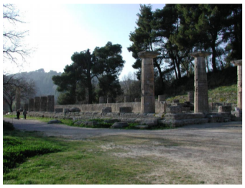
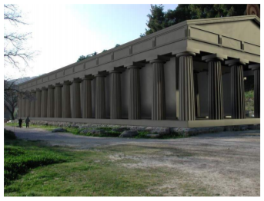
Related work
Stricker, Didier, et al. "Design and development issues for archeoguide: An augmented reality based cultural heritage on-site guide." Proc. Int’l Conf. Augmented Virtual Environments and 3D Imaging. 2001.
Notes:
ARCHEOGUIDE is an interesting project that helps visitors explore and experience ancient artifacts based on their interests or needs. The application was embedded in a personalized electronic device and worked as a tour assistant. Enthusiasts select the site of interest, then the system guides them through the site. The position-orientation tracking component is used as an indicator to display in AR the reconstruction of the ancient buildings

Slide 10
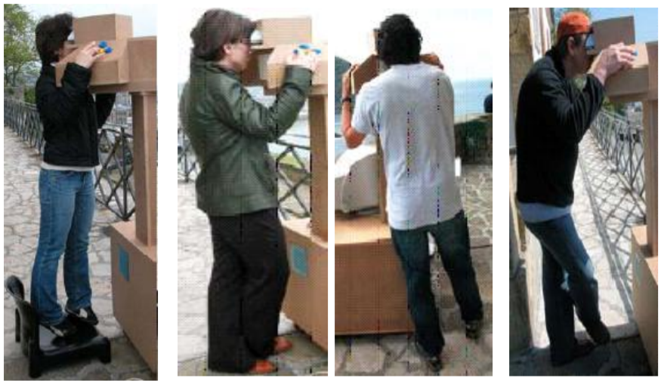
Related work
Fritz, Fabian, Ana Susperregui, and Maria Teresa Linaza. "Enhancing cultural tourism experiences with augmented reality technologies." 6th International Symposium on Virtual Reality, Archaeology and Cultural Heritage (VAST). Vol. 29. 2005.
Notes:
Another interesting project using Augmented Reality was developed by Fritz et al through a project called PRISMA. Similar to the above projects, it employs an AR 3D visualization device capable of working as a tourist guide.

Slide 11
Problem statement
However, the use of Augmented Reality to simulate a series of events
has not been mentioned or investigated
Notes:
Another interesting project using Augmented Reality was developed by Fritz et al through a project called PRISMA. Similar to the above projects, it employs an AR 3D visualization device capable of working as a tourist guide.

Slide 12
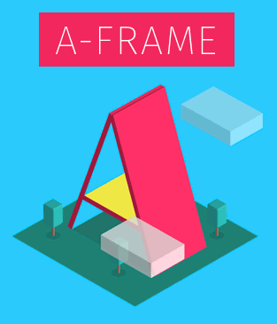
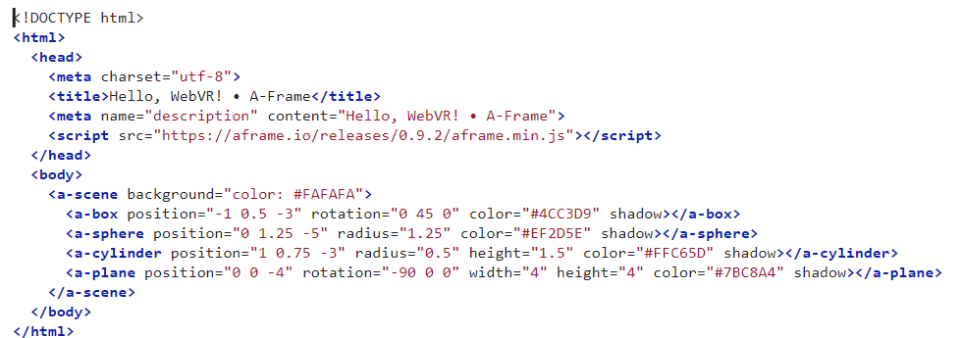
Our design
https://aframe.io/docs/0.9.0/introduction/
Notes:
A-Frame is a web framework for building virtual reality (VR) experiences. A-Frame is based on top of HTML, making it simple to get started. But A-Frame is not just a 3D scene graph or a markup language; the core is a powerful entity-component framework that provides a declarative, extensible, and composable structure to three.js.

Slide 13
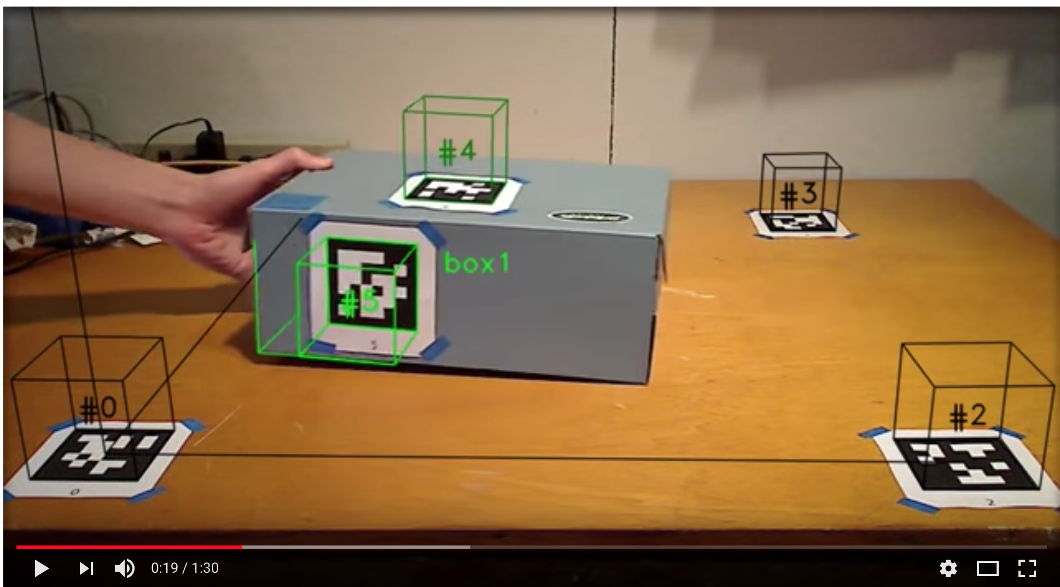
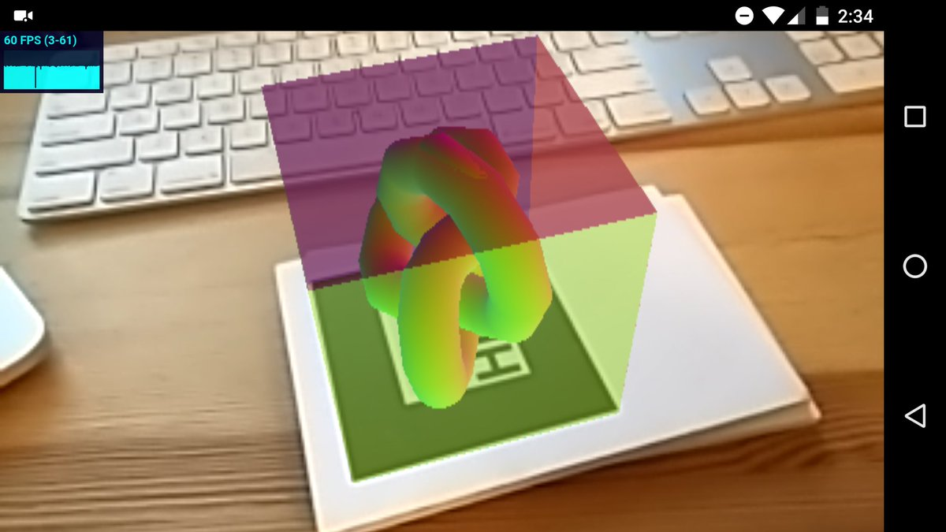
Our design
https://aframe.io/blog/arjs/
Notes:
AR.js is an efficient Augmented Reality solution on the Web. It runs 100% in your web browser, this means no app to install! There is no need for a specific device either e.g. Tango or iphone. It runs on all mobile platforms: Android, iOS11 and Windows mobile. You can use it with your own phone.

Slide 14
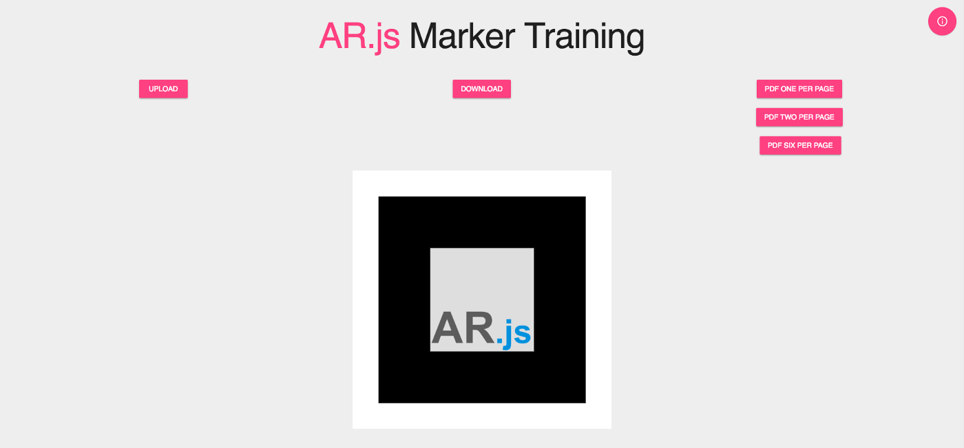
Our design
https://jeromeetienne.github.io/AR.js/three.js/examples/marker-training/examples/generator.html
Notes:
AR.js is an efficient Augmented Reality solution on the Web. It runs 100% in your web browser, this means no app to install! There is no need for a specific device either e.g. Tango or iphone. It runs on all mobile platforms: Android, iOS11 and Windows mobile. You can use it with your own phone.

Slide 15
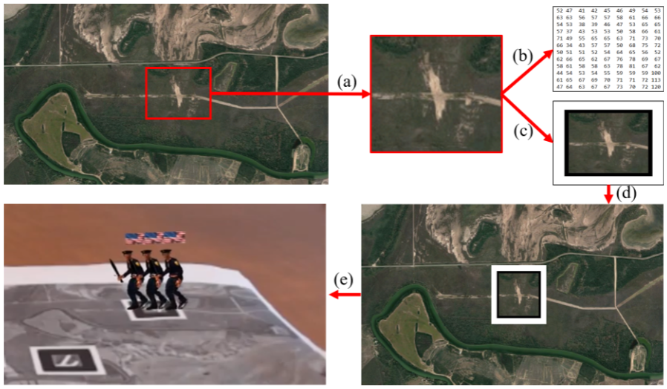
Our design

Slide 16
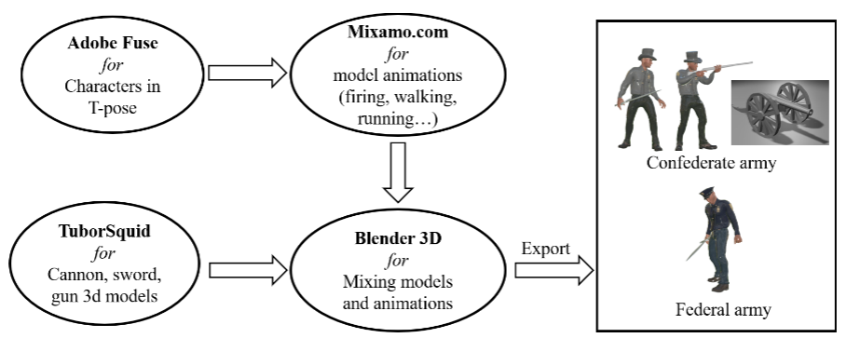
Our design

Slide 17
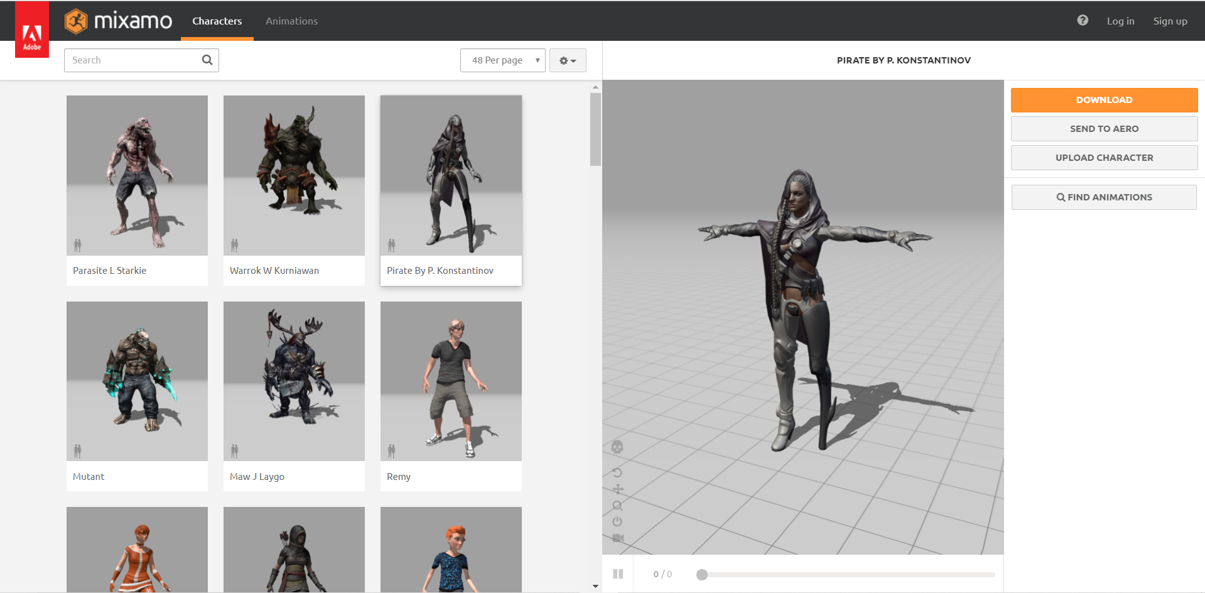
Our design

Slide 18
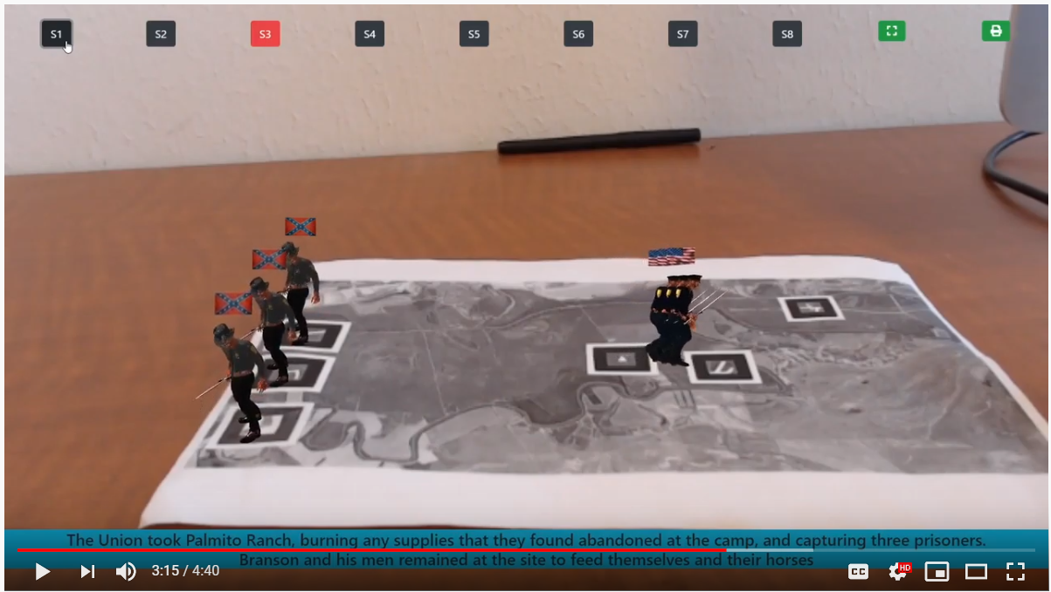
Our design

Slide 19
User study
We conducted a user study with seven participants to evaluate the proposed AR application in terms of perceived ease of use, an essential element of the technology acceptance model.
Overall, all users were excited about the AR application with positive feedback. However, there were some issues with AR app to be addressed as follows:
the 3D models did not look realistic,
the text descriptions were not aligned well on some mobile devices,
audio service was not supported,
less information on the troops was provided (e.g., number of soldiers, casualties of each battle),
a full screen mode was not supported for some devices, (6) there was a flickering issue with the 3D models.

Slide 20
Conclusion and Future work
We presented a Web-based Augmented Reality application that enables viewers to witness a series of battlefield events occurring at the Battle of Palmito Ranch.
The user-friendly interface was evaluated to improve the simulator. This paper is a work-in-progress with several limitations indicated by users in addition to no quantitative method to obtain insights of the user study.
To overcome this issue, we are planning to improve our AR app based on user feedback and perform a full study using the Technology Acceptance Model on task technology, perceived visual design, perceived usefulness, perceived ease of use, self-efficacy, and intention to use for the extended version of this paper in the future.

Slide 21


THANK YOU VERY MUCH

